Slide 1
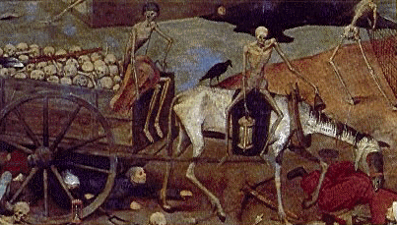
The Black Death

Slide 2
The Black Death killed nearly 2.5 million people in Britain between 1347 and 1350...
Write three things you would like
know about the Black Death!

Slide 3
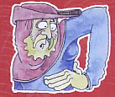
What were the symptoms?
Day 1
Egg-sized lumps (buboes) appeared under the arms and in the groin

Slide 4
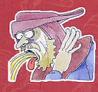
Day 2
The patient began to vomit

Slide 5
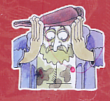
Day 3
Patches appeared on the skin, caused by internal bleeding

Slide 6
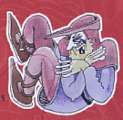
Day 4
The victim suffered uncontrollable muscular spasms.

Slide 7
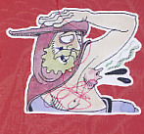
Day 5
If the patient was very lucky, the buboes would burst, releasing black pus. In this case, he/she MAY survive.
Usually, though, the victim would die

Slide 8
What cures did people try?
Carry sweet smelling herbs with you!
Tie a shaved chicken or a dried frog to your buboes!
Pray, and whip yourself to show God that you are sorry for your sin!
Soften your buboes with butter, then cut them open!

Slide 9
The evil planets of Mars and Saturn have moved closer together. This has turned the air bad. If we breathe in the bad air we will catch the plague.
Why?
The plague passes from person to person. Plague sores give off a terrible smell. If you breath this in you will catch the plague.
God has sent the plague because he is angry with us. We have spent too much time gambling, fighting and drinking.

Slide 10
What happened to those who lived?
Between one third and one half of the population died. Whole villages were abandoned. But in some ways, life improved!
Because there were fewer people...
There was more food to go around, so prices fell.
Landlords had to pay more to attract labourers to work for them. Many peasant were freer, and better off than ever before!

Slide 11
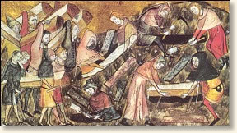
What happened to those who lived?
Just over half the population of England died during the plague.

Slide 12
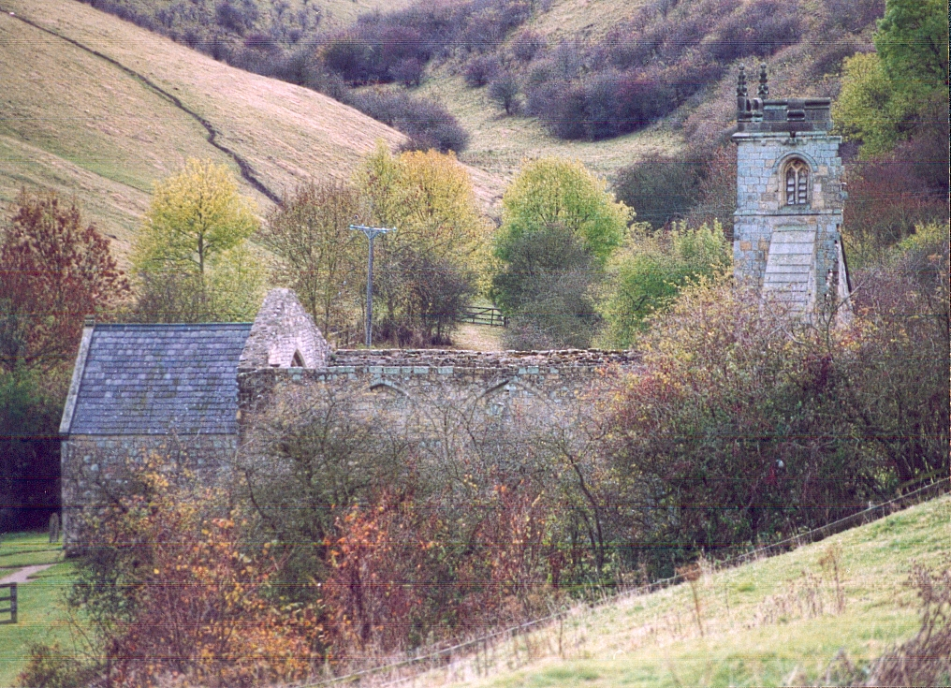
The Survivors
Some villages were abandoned as nearly everyone died in them.

Slide 13
The Survivors
For people who survived the plague every day life got better!
The prices of food and other goods fell and people’s wages went up because there was a shortage of workers.

Slide 14
Task 1
Label the body with the different days and their symptoms
Task 2:
Complete the table on the back of the sheet about reactions to the Plague
Task 3: Design an ad for an apothecary shop! Think about what you know about real medieval cures.

Slide 15
Let’s revisit your questions from the start of the lesson.
Are you now able to answer them?

Slide 16
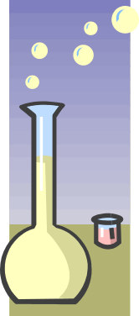


The Olde London Apothecary
Want to avoid the Plague?
We sell herbs to drive out that bad air.
Feeling a bit off colour?
Try one of our amazing plague-trapping toads

